Slide 1
Do you consider yourself a web-developer?

Slide 2

Web-apps ; UI ; Shiny
Beyond static data delivery
Providing decision making tools
Share data
Improve your workflow

Slide 3
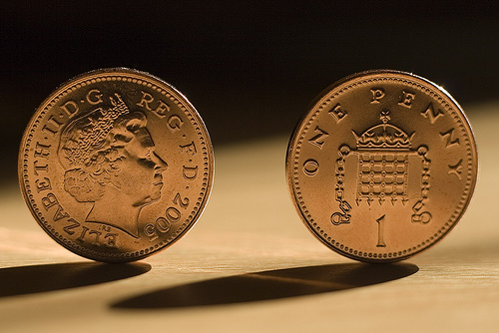

Slide 4
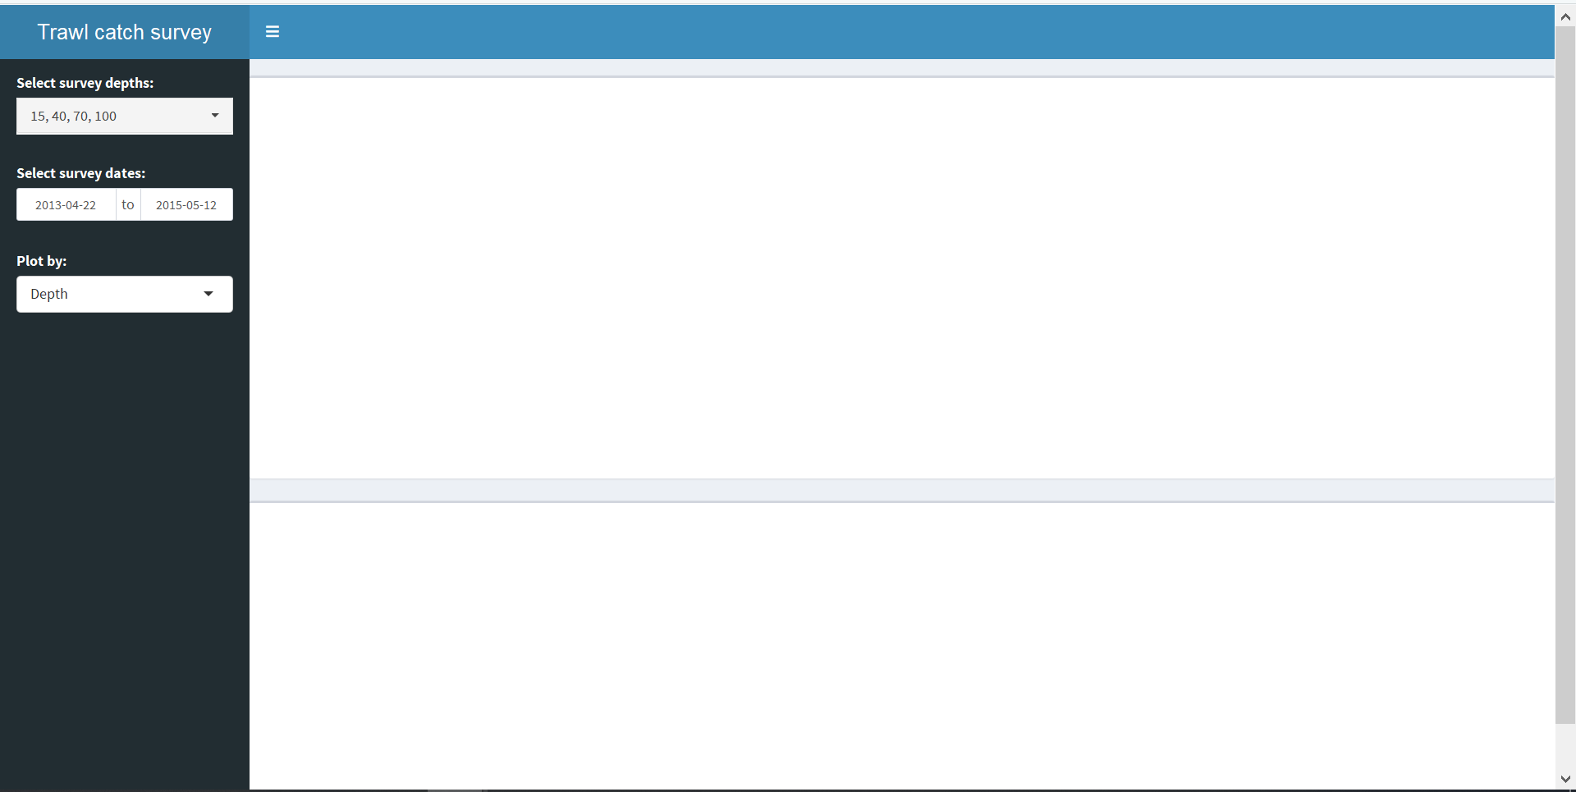
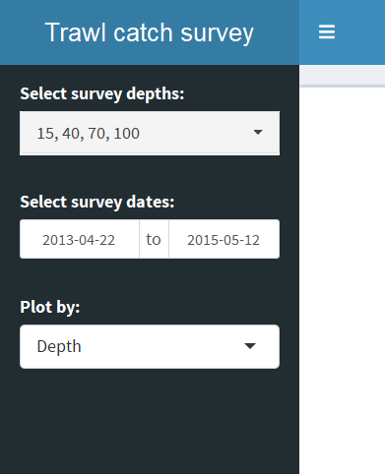
UI side
This is a map
This is a plot

Slide 5
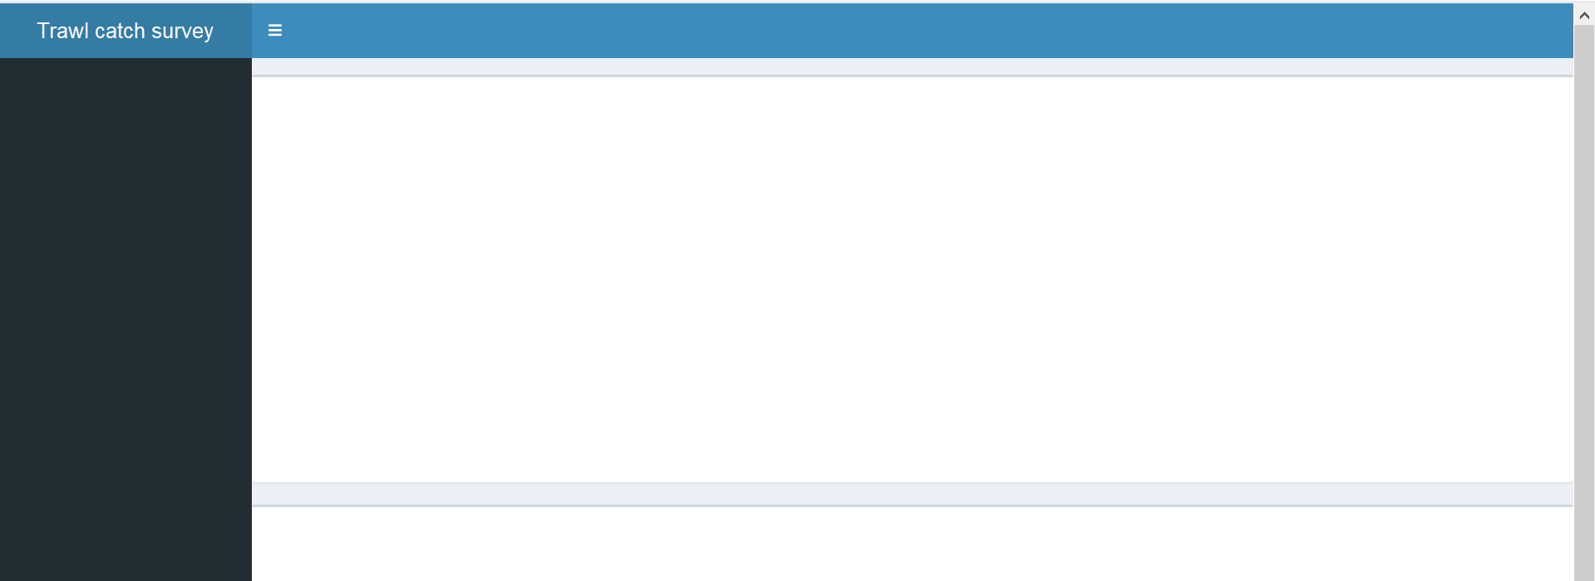
Layout
A thing to minimize the side panel (don’t worry about it ☺)
Header
Side
panel
Main
panel
This is a box
This is a box

Slide 6
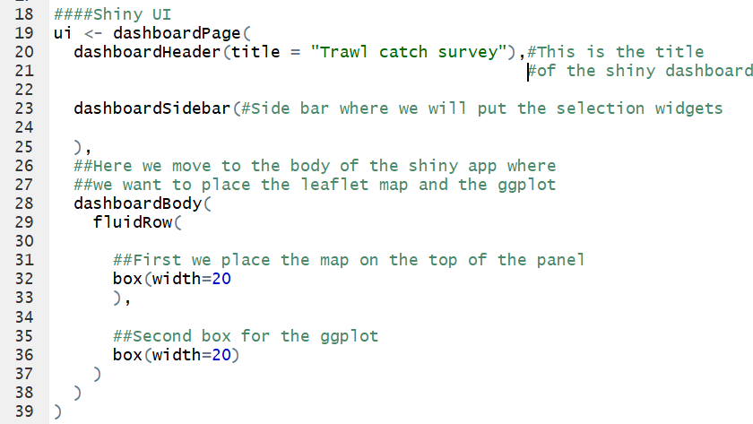
Layout
Watch out!

Slide 7
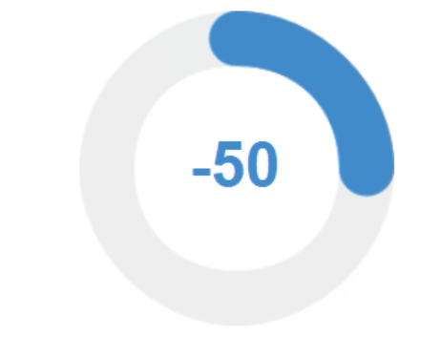
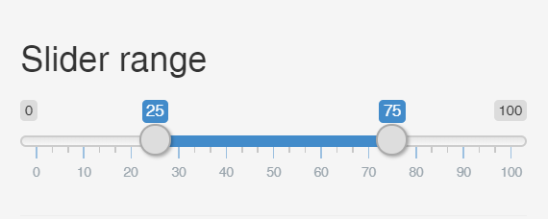
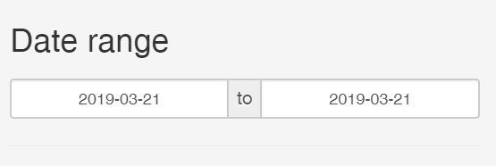
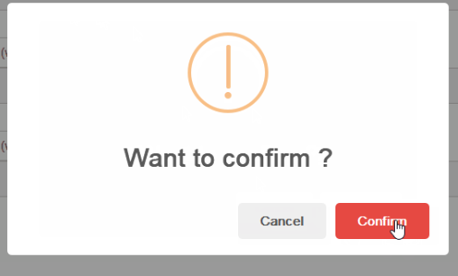
Select widgets
R packages:
Shiny
ShinyWidgets

Slide 8
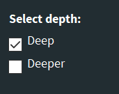
Select widgets
checkboxGroupInput ( inputid=“inp_depth",
label = “Select depth:",
choices = list(“Deep" = 1, “Deeper" = 2),
selected = 1)

Slide 9
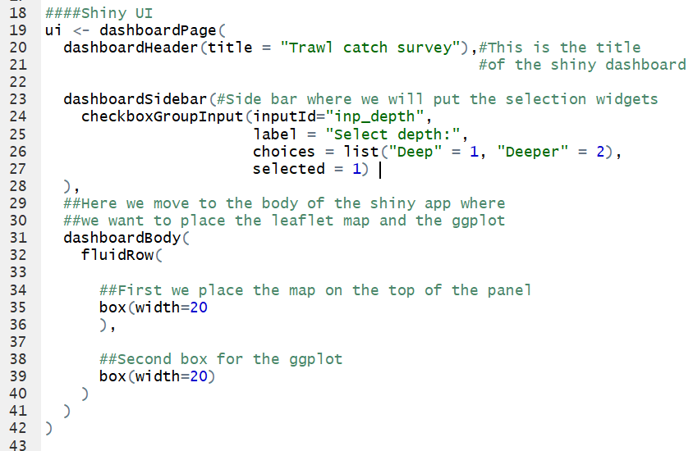
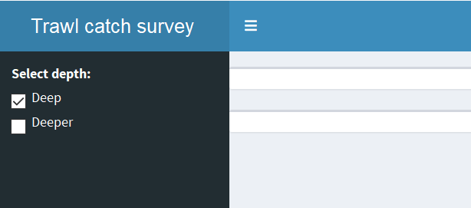
Layout & Select widgets

Slide 10

xxxOutput (plot, leaflet, text etc.)
In the server side we will call ‘render’ function (‘renderPlot’)
We will store the ‘render’ output
And use it in the UI as argument
Server side
UI side

Slide 11
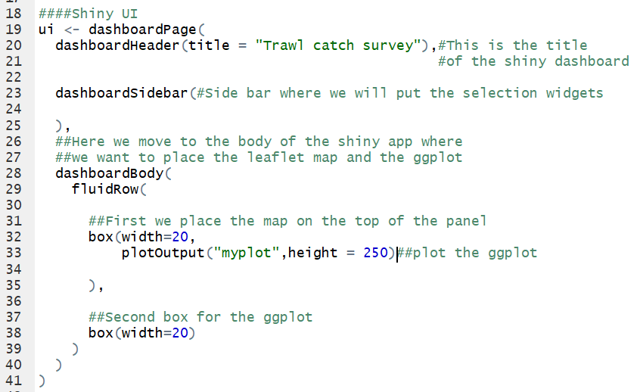
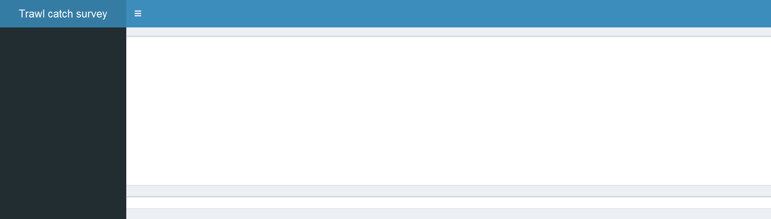
Layout & Output

Slide 12

Server side
Rrrrrr…..

Slide 13

Server

Slide 14
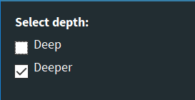

Reactivity
User choose ‘Deeper’
Now input$inp_depth = 2
So we will want to subset some data accordingly
The server side needs to react to the input

Slide 15
Reactivity
Create an output based on user selection
Store value based on selection
Update UI elements based on selection

Slide 16
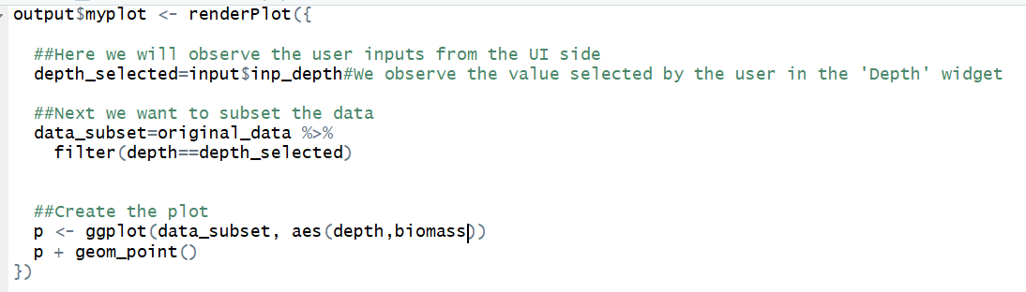
Reactivity
Create an output based on user selection

Slide 17
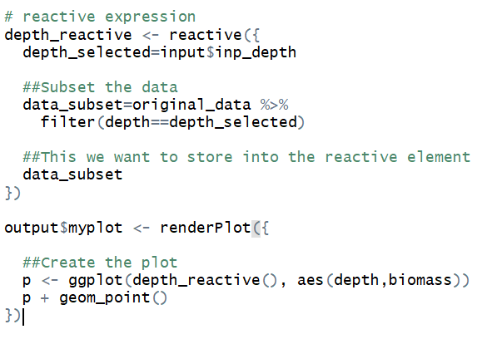
Reactivity
Store value based on selection

Slide 18
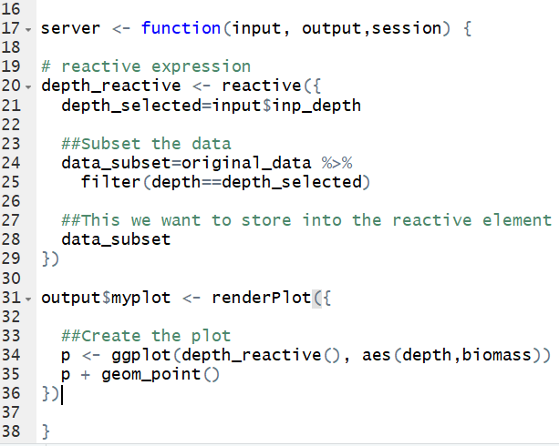
Server side

Slide 19
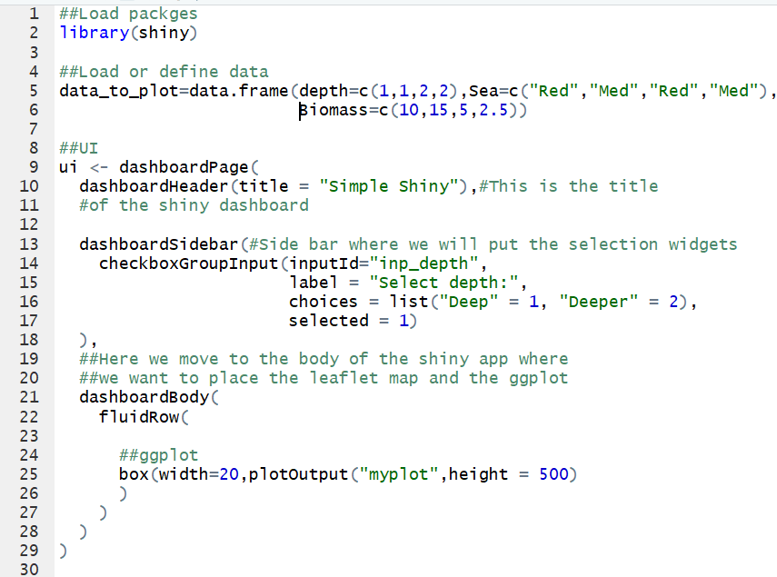
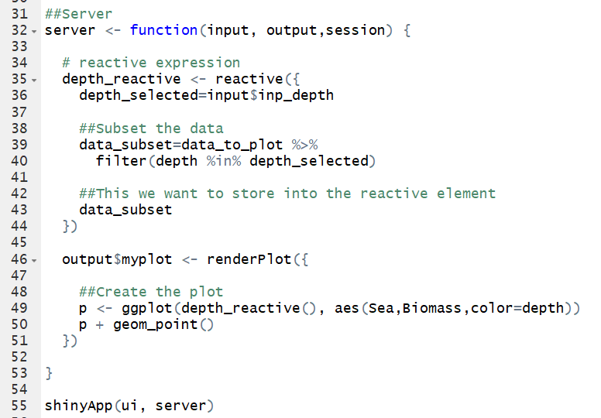
Data + UI + Server = Full Shiny app

Slide 20
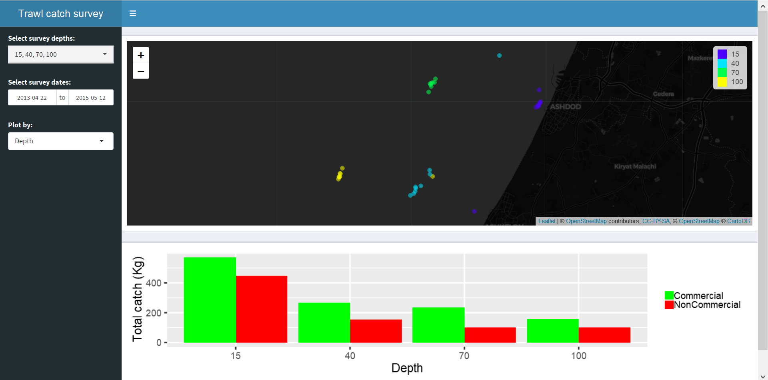
Exercise

